Slide 1
電腦視覺與深度學習 (Computer Vision and Deep Learning) Homework 1
TA:
Lydia: lydia2200284@gmail.com
Office Hour: 17:00~19:00, Mon.
10:00~12:00, Wed.
At CSIE 9F Robotics Lab.

Slide 2
Notices (1/2)
Copying homework is strictly prohibited!! Penalty: Grade will be zero for both persons!!
If the code can’t run, you can come to our Lab within one week and show that your programming can work. Otherwise you will get zero!!
Due date =>Midnight 23:59:59 on 2020/11/04 (Wed.)
No delay. If you submit homework after deadline, you will get 0.
Upload to => 140.116.154.1 -> Upload/Homework/Hw1
User ID: cvdl2020 Password: cvdl2020
Format
Filename: Hw1_StudentID_Name_Version.rar
Ex: Hw1_F71234567_林小明_V1.rar
If you want to update your file, you should update your version to be V2, ex: Hw1_F71234567_林小明_V2.rar
Content: project folder*( including the pictures ) *note: remove your “Debug” folder to reduce file size

Slide 3
Notices (2/2)
Python
Python 3.7 (https://www.python.org/downloads/)
opencv-contrib-python (3.4.2.17)
Matplotlib 3.1.1
UI framework: pyqt5 (5.15.1)
C++ (check MFC guide in ftp)
OpenCV 3.3.1 (https://opencv.org/release.html)
Visual Studio 2015 (download from http://www.cc.ncku.edu.tw/download/)
UI framework: MFC

Slide 4
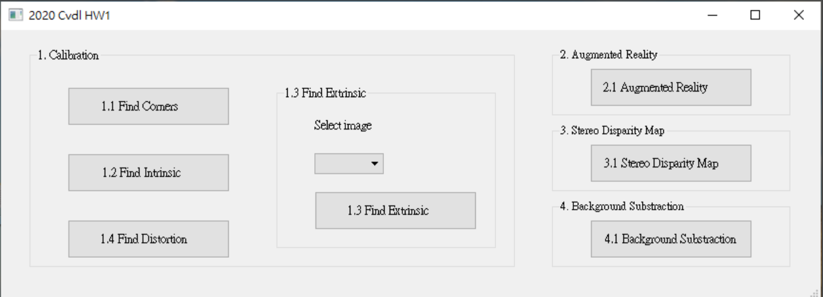
Grading
1. (20%, reference) Camera Calibration (出題：Max)
1.1 Corner detection (5%)
1.2 Find the intrinsic matrix (5%)
1.3 Find the extrinsic matrix (5%)
1.4 Find the distortion matrix (5%)
2. (20%) Augmented Reality (出題：Oran)
3. (20%) Stereo Disparity Map (出題：Mark)
4. (20%) SIFT (出題：Brian)
4.1 Show keypoints (10%)
4.2 Show matching keypoints (10%)
5. (20%) Training Cifar10 Classifier Using VGG16
UI example

Slide 5
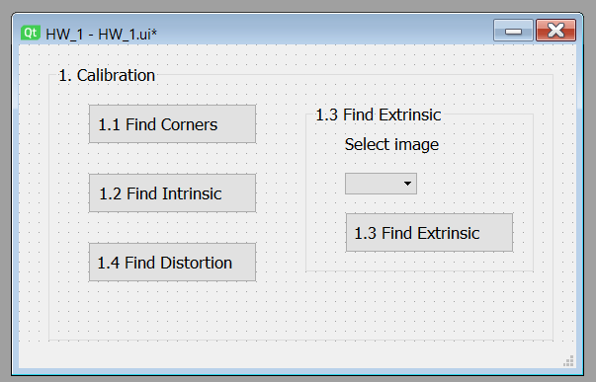
1. (20%) Camera Calibration (出題：Max)
1.1 (5%) Corner detection
1.2 (5%) Find the intrinsic matrix
1.3 (5%) Find the extrinsic matrix
1.4 (5%) Find the distortion matrix

Slide 6
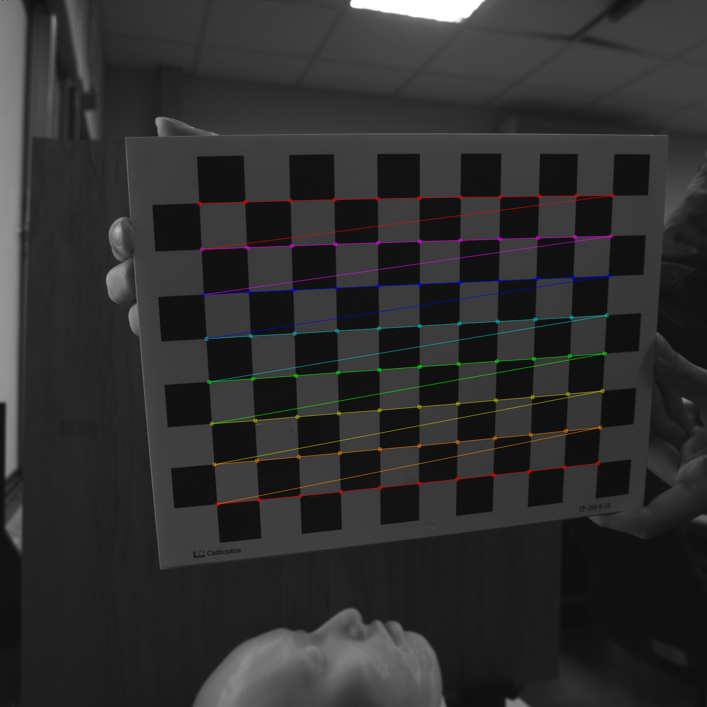
1.1 Corner Detection
Given: 15 images, 1.bmp ~ 15.bmp
Q: 1) Find and draw the corners on the chessboard for each image.
2) Click button “1.1” to show the result.
Hint :
OpenCV Textbook Chapter 11 (p. 398 ~ p. 399)
cvShowImage(…);
Ex:
6

Slide 7
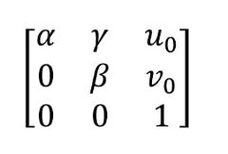
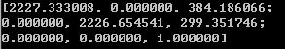
1.2 Find the Intrinsic Matrix
Given: 15 images, 1.bmp ~ 15.bmp
Q: 1) Find the intrinsic matrix ():
2) Click button “1.2” and then show the result on the console window.
Output format:
Hint: OpenCV Textbook Chapter 11 (P.398 ~ p.400)
(Just an example)

Slide 8
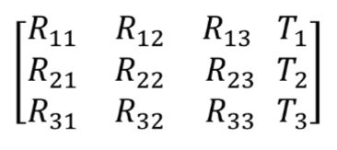
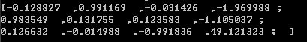
1.3 Find the Extrinsic Matrix
Given: intrinsic parameters, distortion coefficients, and the list of 15 images
Q: 1) Find the extrinsic matrix of the chessboard for each of the 15 images, respectively:
2) Click button “1.3” and then show the result on the console window.
Output format:
Hint: OpenCV Textbook Chapter 11, p.370~402
(Just an example)
(1) List of numbers: 1~15
(2) Select 1, then 1.bmp will be applied, and so on

Slide 9
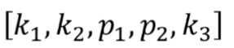
1.4 Find the Distortion Matrix
Given: 15 images
Q: 1) Find the distortion matrix:
2) Click button “1.4” to show the result on the console window.
Output format:
Hint:
Distortion coefficients can be obtained simultaneously with intrinsic parameters
OpenCV Textbook Chapter 11 (P.398 ~ p.400)
(Just
an example)

Slide 10
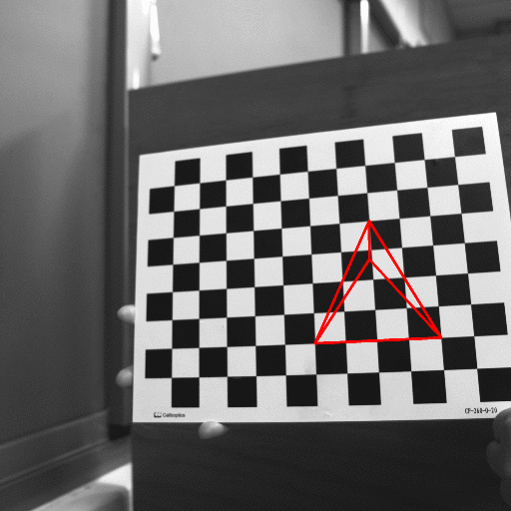
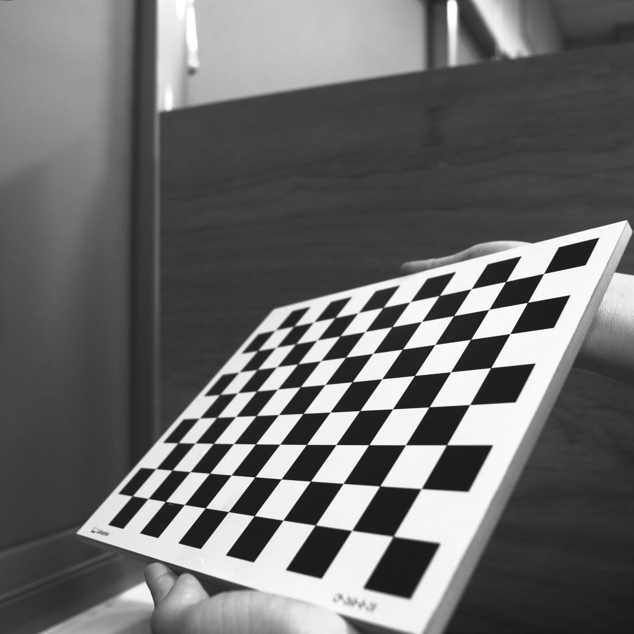
2. (20%) Augmented Reality (出題：Oran)
Given: 5 images: 1~5.bmp
Q:
1) Calibrate 5 images to get intrinsic, distortion and extrinsic parameters
2) Draw a “tetrahedron” on the chessboards images(1.bmp to 5.bmp)
3) Click the button to show the tetrahedron on the picture. Show each picture 0.5 seconds (total 5 images)
Hint : Textbook Chapter 11, p.387~395 Calibration
p.405~412 Projection
cv::calibrateCamera()
cv::projectPoints()
Demo:
3D Object coordinates:
Vertex (3, 3, -3)
Corners(1, 1, 0)(3, 5, 0)(5, 1, 0)
(3,3,0)
(3, 3, -3)
(3, 5, 0)
(5, 1, 0)
(1, 1, 0)

Slide 11
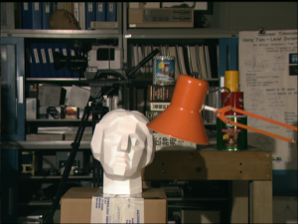
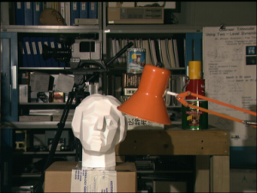
3. (20%) Stereo Disparity Map (出題：Mark)
Given: a pair of images, imL.png and imR.png (have been rectified)
Q: Find the disparity map/image based on Left and Right stereo images.
imL.png
imR.png
Left Image (Reference Image)
Right Image

Slide 12
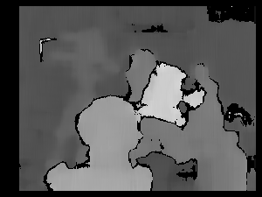
3.1 (20%) Disparity Map
Guides:
(1) Window Size: Must be odd and within the range [5, 255]
(2) Search range and direction:
Disparity range:
Must be positive and divisible by 16.
Map disparity range to gray value range 0~255 for the purpose of visualization.
If the left image is the reference image (the one used to cal. depth info for each pixel of that img), then the search direction at right image will go from the right to left direction.
Hint: OpenCV Textbook Chapter 12 (P.451)
StereoBM::create(64, 9);
Result

Slide 13
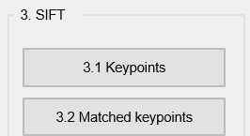
4. (20%) SIFT (出題：)
User interface for the third question:
4.
4.
4.

Slide 14
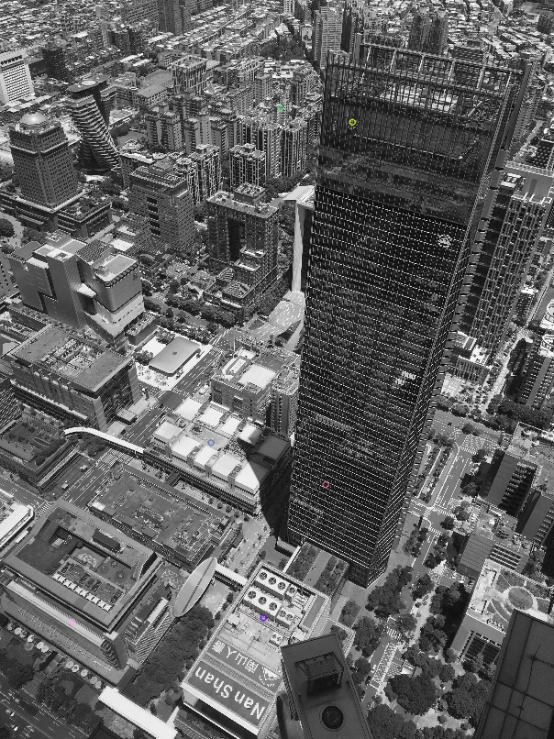
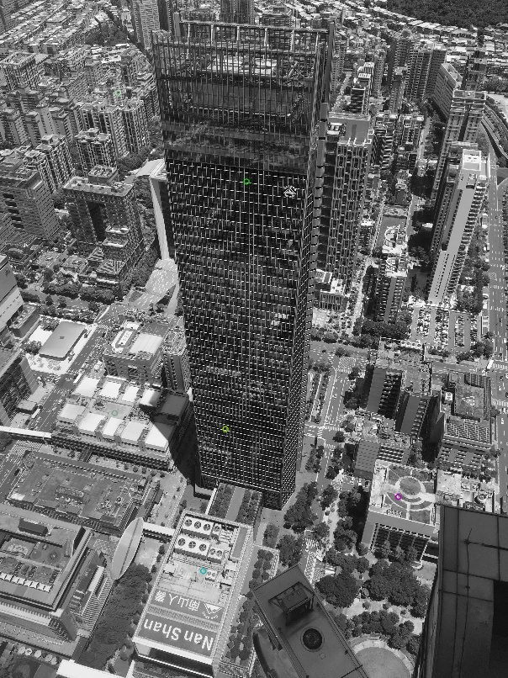
4. (20%) SIFT (出題：)
Q: 4.1) (10%) Click button “4.1 Keypoints” to show:
Aerial1.jpg and Aerial2.jpg
then save results as FeatureAerial1.jpg and FeatureAerial2.jpg as figure 1:
FeatureAerial1.jpg
Figure 1. Feature points on two images.
FeatureAerial2.jpg
Hint : (ref. : opencv2refman_2.4.7.pdf) ref. p663 ~ p670

Slide 15
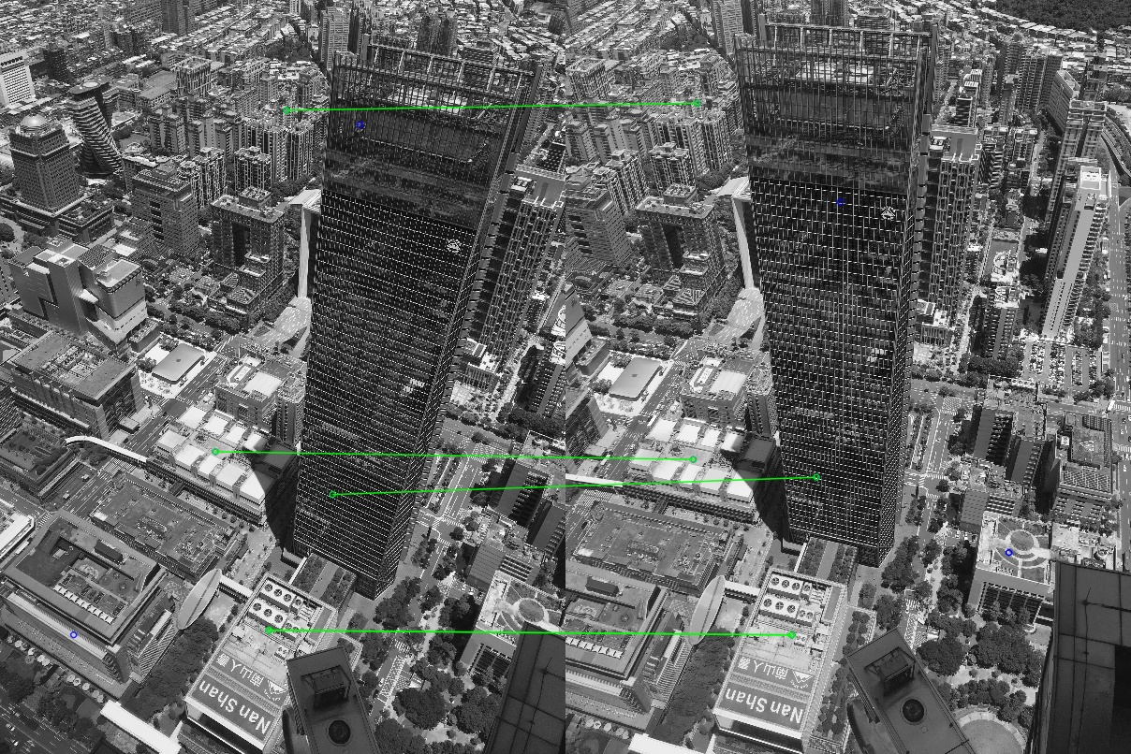
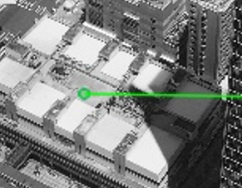
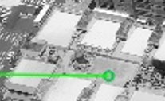
4. (20%) SIFT (出題：)
Q: 4.2) (10%) Click button “4.2 Matched Keypoints”,
draw the matched feature points between two images from 6 keypoints pairs obtained in Q: 4.1) and show the results as Figure 2:
Aerial1.jpg
Aerial2.jpg
Figure 2. Feature points and their corresponding points.
Hint : (ref. : opencv2refman_2.4.7.pdf) ref. p663 ~ p670

Slide 16
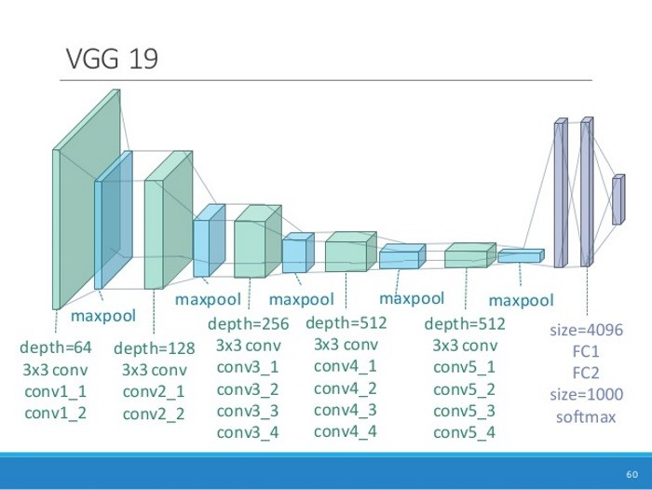
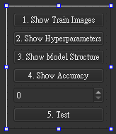
5.0 Training Cifar10 Classifier Using VGG16 (出題：Kevin)
Learn how to construct VGG16 and train it on Cifar10.
Environment Requirement
Python 3.6
Tensorflow 2 / PyTorch 1.3.0
opencv-contrib-python 3.4.2.17 (for image show and write)
Matplotlib 3.1.1 (for chart drawing)
Reference
Very Deep Convolutional Networks for Large-Scale Image Recognition(VGG16)
https://www.cs.toronto.edu/~kriz/cifar.html(Cifar10)
16
input(224x224x3)
input(112x112x64)
flatten
input(56x56x128)
input(28x28x256)
input(14x14x512)
2x2
2x2
2x2
2x2
2x2
10
GUI example
VGG16 framework
Notes:
pip install torch==1.3.0+cpu torchvision==0.7.0+cpu -f https://download.pytorch.org/whl/torch_stable.html

Slide 17
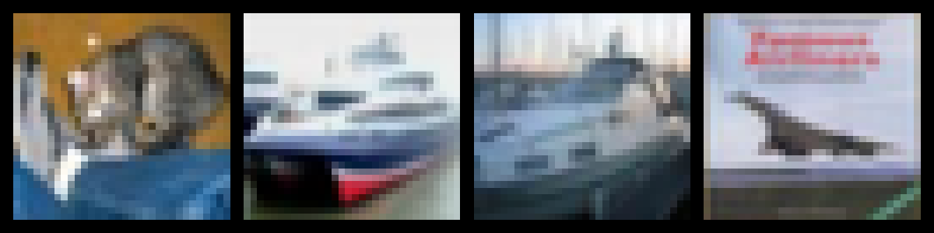
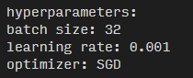
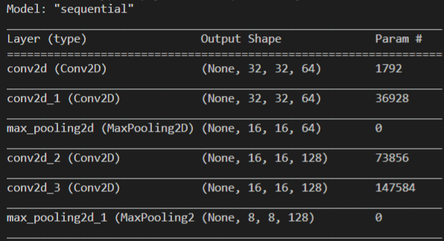
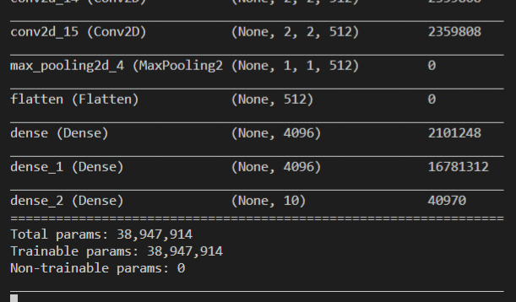
5.1 Load Cifar10 training dataset and randomly show 10 images and labels respectively. (4%)
5.2 Print out training hyperparameters (batch size, learning rate, optimizer). (4%)
5.3 Construct and show your model structure. (Build it your self, do not use architecture provided by ML framework) (4%)
…
Label: cat ship ship airplane …
0 airplane
1 automobile
2 bird
3 cat
4 deer
5 dog
6 frog
7 horse
8 ship
9 truck
…

Slide 18
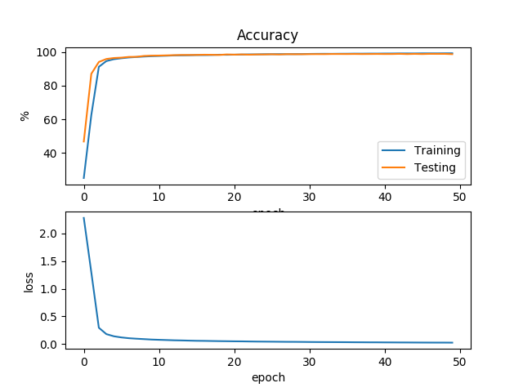
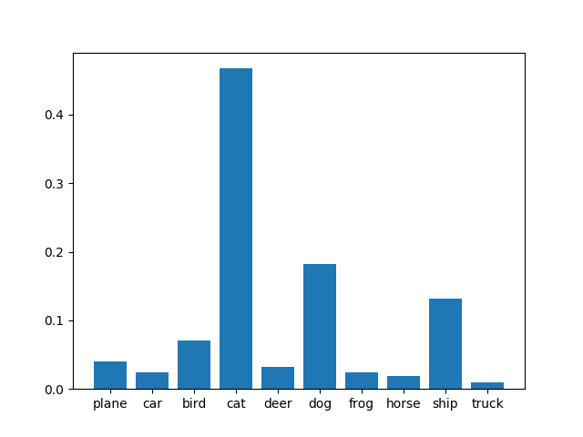
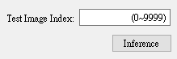
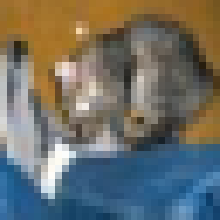
5.4 Training your model at least 20 epochs by your own computer, than save your model and take a screenshot of your training loss and accuracy. No saved images no points (4%) (you only need to show the screenshot image , DO NOT train in homework UI)
5.5 Load your model trained at 5.4, let us choose one image from test images, inference the image, show image and estimate the image as following. No saved model no points (4%)
(record accuracy/loss per epoch)

